Slide 1
Quasigroups Defaults
Foundations of AI

Slide 2
Quasigroup or Latin Squares
Given an N X N matrix, and given N colors, color the matrix in such a way that:
-all cells are colored;
- each color occurs exactly once in each row;
- each color occurs exactly once in each column;
Quasigroup or Latin Square

Slide 3
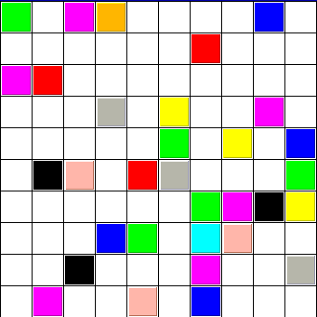
Quasigroup Completion Problem (QCP)
Given a partial assignment of colors (10 colors in this case), can the partial quasigroup (latin square) be completed so we obtain a full quasigroup?
Example:
32% preassignment

Slide 7
Demonstration

Slide 8
QCP: A Framework for Studying Search
NP-Complete.
Random instances have structure not found in random k-SAT
Closer to “real world” problems!
Can control hardness via % preassignment
(Anderson 85, Colbourn 83, 84, Denes & Keedwell 94, Fujita et al. 93, Gent et al. 99, Gomes & Selman 97, Gomes et al. 98, Shaw et al. 98, Walsh 99 )

Slide 9
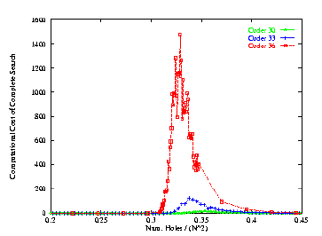
Easy-Hard-Easy Pattern in Backtracking Search
Complete (Satz) Search
Order 30, 33, 36
QWH peaks near 32%
(QCP peaks near 42%)
Computational Cost
% holes

Slide 10
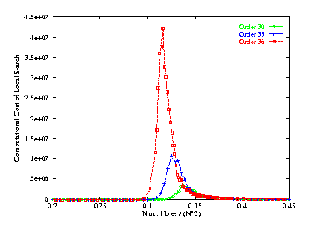
Easy-Hard-Easy Pattern in Local Search
Local (Walksat) Search
Order 30, 33, 36
Computational Cost
% holes
First solid statistics for overconstrainted area!

Slide 11
Next Programming Assignment
Solving Quasigroup Completion Problems
Write a Prolog program to solve directly
Use Prolog to generate a propositional SAT formula, then solve the SAT problem using your SAT solver (or my own implementation of Walksat)
Details will be posted by Saturday morning

Slide 12
Default Reasoning

Slide 13
Generic vs. Universal Statements
Which of the following are universally true?
Violins have 4 strings.
The classical violin has 4 strings.
A normal classical violin has 4 strings
Dogs have 4 legs
Normal dogs have 4 legs
But what is "normal"?

Slide 14
Generics vs. Statistical Knowledge
Is generic knowledge just statistical?
Dogs have fur.
The concepts of "dogginess" is inseparable from "furriness"
99% of dogs have fur
99% of Americans have a first name that ends in a consonant
Americans have first name that end in consonants (?!)

Slide 15
Kinds of Default Reasoning
General Statements
Generic or prototypical: Dogs have fur
Statistical: Most Republicans are against gun laws
Conventions of Human Interaction
"Most people got an A in 444" -> not the case that everyone got an A in 444
Based on lack of information
I believe I haven't won a Macarther Genius award
Based on an explicit exhaustive knowledge
Mary is not registered for my class, because she is not listed on the class roster.

Slide 16
Closed-World Assumption
Unless an atomic sentence is known to be true, it can be assumed to be false.
Prolog: goal "not P" means "not provable"
\+/ p(e)
Recall: \+/ p(E) means \+/ Exists E . p(E)
KB+ = KB U {~p | p is atomic and not KB|=p}
What could go wrong?

Slide 17
Problem: Disjunctions
Suppose KB = { p V q }
Then KB+ = { p V q, ~p, ~q }
Thus: CWA cannot be safely applied to a KB that contains positive disjunctive statements.
Prolog has no positive disjunctive statements.
Is CWA safe for Prolog?

Slide 18
CWA vs. \+/
Consider Prolog program:
q :- \+/ p.
p :- \+/ q.
Is q provable? Is p provable?
Is ~q in KB+? What about ~p?
p is not provable, but we can't allow ~p in KB+, because then q should be provable (and vice versa)
However: CWA and \+/ coincide if the Prolog program is "stratified"
Never apply \+/ to a predicate that appears EARLIER in the program.

Slide 19
CWA and Databases
CWA is typically used in ordinary databases.
DB table: Prolog relation specified by enumerating positive literals.
DB view: non-recursive pure Prolog clause.
Key property: DB |= (p V q) iff
DB |= p OR DB |= q
How is this different from the general case of logical entailment?

Slide 20
Beyond the CWA
Much work in AI in 1970-1999 on more general formalisms for default reasoning
Generalized CWA
Circumscription
Default logic
Autoepistemic logic
Various probabilistic (statistical) representations
During last decade, almost all work has been on statistical methods (Bayes nets, etc)
But, even in statistical representations, default assumptions implicitly appear
"independence assumptions" in a Bayesian network
Some kind of default reasoning is inescapable!

Slide 21
Default Logic
Extends FOL with default rules
Oridinary FOL: {provable} / {conclusion}
Default rule:
{provable} : {consistent} / conclusion
Why is this any better than \+/ ~{consistent}?
The "consisent" check is against the full, final set of logical consequences of the theory
Full set of consequences = Extension

Slide 22
Default Logic
Normal Default theory: the {conclusion} is included in the {consistent} check
Theorem: every normal default theory has at least one extension.

