Slide 1
Logical Foundations of AI
SAT
Henry Kautz

Slide 2
Resolution Refutation Proof
DAG, where leaves are input clauses
Internal nodes are resolvants
Root is false (empty clause)
KB:
If the unicorn is mythical, then it is immortal,
if it is not mythical, it is an animal
If the unicorn is either immortal or an animal, then it is horned.
Prove: the unicorn is horned.
(~ A , H)
(~ H)
(~I , H)
(M , A)
(~A)
(~I)
(~ M, I)
(M)
(~ M)
()
Notes:
A resolution proof is a tree where
leafs are input clauses
internal nodes are resolvants
root is false (empty clause)

Slide 3
Today and Thursday
Backtracking Search for SAT
Scaling of Modern DPLL Implementations
Local Search for SAT
N-Queens Demonstration
Planning as Satisfiability
SATPLAN Demo

Slide 4
Efficient Backtrack Search for Satisfiability Testing

Slide 5
Basic Backtrack Search for a Satisfying Model
Solve( F ): return Search(F, { });
Search( F, assigned ):
if all variables in F are in assigned then
if assigned |= F then return assigned;
else return FALSE;
choose unassigned variable x;
return Search(F, assigned U {x=0}) ||
Search(F, assigned U {x=1});
end;
Is this algorithm complete?
What is its running time?

Slide 6
Basic Backtrack Search for a Satisfying Model
Solve( F ): return Search(F, { });
Search( F, assigned ):
if all variables in F are in assigned then
if assigned |= F then return assigned;
else return FALSE;
choose unassigned variable x;
return Search(F, assigned U {x=0}) ||
Search(F, assigned U {x=1});
end;
Is this algorithm complete? YES
What is its running time?

Slide 7
Basic Backtrack Search for a Satisfying Model
Solve( F ): return Search(F, { });
Search( F, assigned ):
if all variables in F are in assigned then
if assigned |= F then return assigned;
else return FALSE;
choose unassigned variable x;
return Search(F, assigned U {x=0}) ||
Search(F, assigned U {x=1});
end;
Is this algorithm complete? YES
What is its running time? O(n) and o(n)

Slide 8
Propagating Constraints
Suppose formula contains
  (A v B v ~C)
and we set A=0.
What is the resulting constraint on the remaining variables B and C?
  (B v ~C)
Suppose instead we set A=1. What is the resulting constraint on B and C?
  No constraint

Slide 9
Empty Clauses and Formulas
Suppose a clause in F is shortened until it become empty. What does this mean about F and the partial assignment?
  F cannot be satisfied by any way of completing the assignment; must backtrack
Suppose all the clauses in F disappear. What does this mean?
  F is satisfied by any completion of the partial assignment

Slide 10
Better Backtrack Search
Search( F, assigned ):
if F is empty then return assigned;
if F contains [ ] then return FALSE;
choose an unassigned variable c
return Search(F • c, assigned U {c}) ||
Search(F • ~c , assigned U {~c});
end
F• L = remove clauses from F that contain literal L, and
shorten clauses in F that contain ~L

Slide 11
Unit Propagation
Suppose a clause in F is shortened to contain a single literal, such as
  (L)
What should you do?
  Immediately add the literal to assigned.
  This may shorten some clauses and erase other clauses.
  Repeat if another single-literal clause appears.

Slide 12
Even Better Backtrack Search
Search( F, assigned ):
if F is empty then return assigned;
if F contains [ ] then return FALSE;
if F contains a unit clause [L] then
return Search(F • L, assigned U {L})
else
choose an unassigned variable c
return Search(F • c, assigned U {c}) ||
Search(F • ~c , assigned U {~c});
end
F• L = remove clauses from F that contain literal L, and
shorten clauses in F that contain ~L

Slide 13
Pure Literal Rule
Suppose a literal L appears in F, but the negation of L never appears. What should you do?
  Immediately add the literal to assigned.
  This will erase some clauses, but not shorten any.

Slide 14
Davis-Putnam-Logemann-Loveland Procedure (DPLL)
DPLL( F, assigned ):
if F is empty then return assigned;
if F contains [ ] then return FALSE;
if F contains a unit clause [L] or a pure literal L then
return Search(F • L, assigned U {L})
else
choose an unassigned variable c
return Search(F • c, assigned U {c}) ||
Search(F • ~c , assigned U {~c});
end
F• L = remove clauses from F that contain literal L, and
shorten clauses in F that contain ~L

Slide 15
DPLL on the Unicorn
(~ M, I)
(I)
H
(M , A)
(M)
A
(~I , H)
(~I)
( )
(~ A , H)
(~A)
M
(~ H)
I
NO SEARCH!
Notes:
A resolution proof is a tree where
leafs are input clauses
internal nodes are resolvants
root is false (empty clause)

Slide 16
Converting DPLL Tree to a Resolution Proof
Add missing branches
Attach clauses to leafs
Label interior nodes with resolution of children
H
( )
A
(H)
(~ H)
M
(A, H)
(~ A , H)
I
(M , A)
(~ M, H)
(~I , H)
(~ M, I)
Notes:
A resolution proof is a tree where
leafs are input clauses
internal nodes are resolvants
root is false (empty clause)

Slide 17
DPLL and Resolution
DPLL is thus computational equivalent to creating a tree-shaped resolution proof
In theory, since resolution is not restricted to tree-shaped proofs, it should be "better"
In practice, the overhead of resolution makes it much worse

Slide 18
Scaling Up
For decades, DPLL was considered only useful for "toy" problems
Starting around 1996, researchers improved DPLL using
  Good heuristics for choosing variable for branching
  Caching
  Clever Data Structures
Today, modern versions of DPLL are used to solve big industrial problems in hardware and software verification, automated planning and scheduling, cryptography, and many other areas

Slide 19
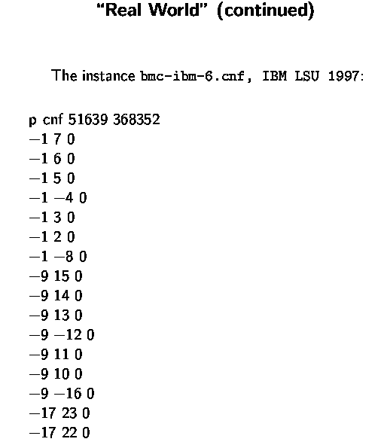
What is BIG?
Consider a real world Boolean Satisfiability (SAT) problem
I.e., ((not x_1) or x_7)
((not x_1) or x_6)
etc.
x_1, x_2, x_3, etc. our Boolean variables
(set to True or False)
Set x_1 to False ??

Slide 20
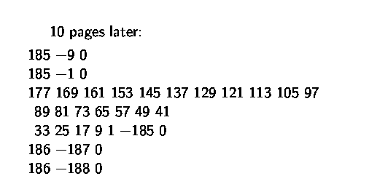
10 pages later:
…
I.e., (x_177 or x_169 or x_161 or x_153 …
x_33 or x_25 or x_17 or x_9 or x_1 or (not x_185))
clauses / constraints are getting more interesting…
Note x_1 …

Slide 21

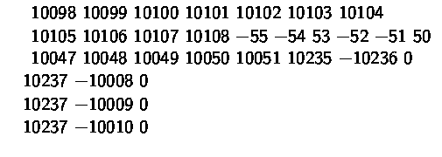
4000 pages later:
…

Slide 22
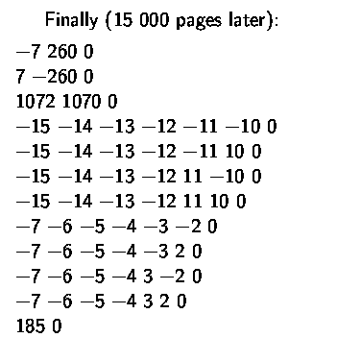
Finally, 15,000 pages later:
Search space of truth assignments:
HOW?
Current SAT solvers solve this instance in
approx. 1 minute!

Slide 23
Local Search Strategies: From N-Queens to Walksat

Slide 24
Greedy Local Search
state = choose_start_state();
while ! GoalTest(state) do
  state := arg min { h(s) | s in Neighbors(state) }
end
return state;
Terminology:
  “neighbors” instead of “children”
  heuristic h(s) is the “objective function”, no need to be admissible
No guarantee of finding a solution
  sometimes: probabilistic guarantee
Best goal-finding, not path-finding
Many variations

Slide 25
N-Queens Local Search, Version 1
state = choose_start_state();
while ! GoalTest(state) do
  state := arg min { h(s) | s in Neighbors(state) }
end
return state;
start = put down N queens randomly
GoalTest = Board has no attacking pairs
h = number of attacking pairs
neighbors = move one queen randomly

Slide 26
N-Queens Local Search, Version 2
state = choose_start_state();
while ! GoalTest(state) do
  state := arg min { h(s) | s in Neighbors(state) }
end
return state;
start = put a queen on each square with 50% probability
GoalTest = Board has N queens, no attacking pairs
h = number of attacking pairs + # rows with no queens
neighbors = add or delete one queen

Slide 27
N Queens Demo

Slide 28
SAT Translation
At least one queen each row:
  (Q11 v Q12 v Q13 v ... v Q18)
  (Q21 v Q22 v Q23 v ... v Q28)
  ...
No attacks:
  (~Q11 v ~Q12)
  (~Q11 v ~Q22)
  (~Q11 v ~Q21)
  ...
O(N²) clauses
O(N³) clauses

Slide 29
Greedy Local Search for SAT
state = choose_start_state();
while ! GoalTest(state) do
  state := arg min { h(s) | s in Neighbors(state) }
end
return state;
start = random truth assignment
GoalTest = formula is satisfied
h = number of unsatisfied clauses
neighbors = flip one variable

Slide 30
Local Search Landscape
# unsat clauses

Slide 31
States Where Greedy Search Must Succeed
# unsat clauses

Slide 32
States Where Greedy Search Must Succeed
# unsat clauses

Slide 33
States Where Greedy Search Might Succeed
# unsat clauses

Slide 34
States Where Greedy Search Might Succeed
# unsat clauses

Slide 35
Local Search Landscape
Plateau
# unsat clauses
Local Minimum

Slide 36
Variations of Greedy Search
Where to start?
  RANDOM STATE
  PRETTY GOOD STATE
What to do when a local minimum is reached?
  STOP
  KEEP GOING
Which neighbor to move to?
  (Any) BEST neighbor
  (Any) BETTER neighbor
How to make greedy search more robust?

Slide 37
Restarts
for run = 1 to max_runs do
state = choose_start_state();
flip = 0;
while ! GoalTest(state) && flip++ < max_flips do
state := arg min { h(s) | s in Neighbors(state) }
end
if GoalTest(state) return state;
end
return FAIL

Slide 38
Uphill Moves: Random Noise
state = choose_start_state();
while ! GoalTest(state) do
with probability noise do
state = random member Neighbors(state)
else
state := arg min { h(s) | s in Neighbors(state) }
end
end
return state;

Slide 39
Uphill Moves: Simulated Annealing (Constant Temperature)
state = start;
while ! GoalTest(state) do
next = random member Neighbors(state);
deltaE = h(next) – h(state);
if deltaE < 0 then
state := next;
else
with probability e^{-deltaE/temperature} do
state := next;
end
endif
end
return state;

Slide 40
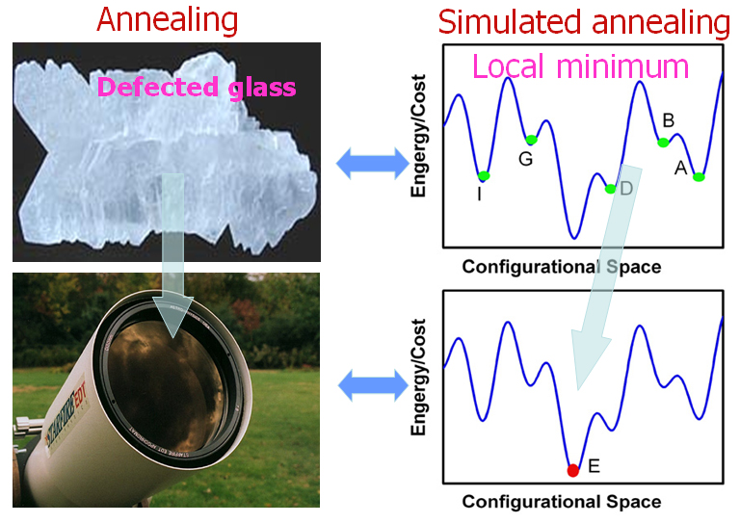

Slide 41
Uphill Moves: Simulated Annealing (Geometric Cooling Schedule)
temperature := start_temperature;
state = choose_start_state();
while ! GoalTest(state) do
next = random member Neighbors(state);
deltaE = h(next) – h(state);
if deltaE < 0 then
state := next;
else
with probability e^{-deltaE/temperature} do
state := next;
end
temperature := cooling_rate * temperature;
end
return state;

Slide 42
Simulated Annealing
For any finite problem with a fully-connected state space, will provably converge to optimum as length of schedule increases:
But: fomal bound requires exponential search time
In many practical applications, can solve problems with a faster, non-guaranteed schedule

Slide 43
Coming Up
Today:
  Local search for SAT, continued: Walksat
  Planning as Satisfiability
  Implementing DPLL efficiently
Tuesday 19 October:
  Advanced SAT techniques: clause learning and symmetry elimination
  No readings due
Thursday 21 October: Midterm
Tuesday 26 October: Prolog
  Readings due on the 25th
  SAT Solver project due 11:45 pm Oct 26

Slide 44
Smarter Noise Strategies
For both random noise and simulated annealing, nearly all uphill moves are useless
Can we find uphill moves that are more likely to be helpful?
At least for SAT we can...

Slide 45
Random Walk for SAT
Observation: if a clause is unsatisfied, at least one variable in the clause must be different in any global solution
  (A v ~B v C)
Suppose you randomly pick a variable from an unsatisfied clause to flip. What is the probability this was a good choice?

Slide 46
Random Walk for SAT
Observation: if a clause is unsatisfied, at least one variable in the clause must be different in any global solution
  (A v ~B v C)
Suppose you randomly pick a variable from an unsatisfied clause to flip. What is the probability this was a good choice?

Slide 47
Random Walk Local Search
state = choose_start_state();
while ! GoalTest(state) do
  clause := random member { C | C is a clause of F and
  C is false in state }
  var := random member { x | x is a variable in clause }
  state[var] := 1 – state[var];
end
return state;

Slide 48
Properties of Random Walk
If clause length = 2:
  50% chance of moving in the right direction
  Converges to optimal with high probability in O(n²) time
reflecting

Slide 49
Properties of Random Walk
If clause length = 2:
  50% chance of moving in the right direction
  Converges to optimal with high probability in O(n²) time
For any desired epsilon, there is a constant C, such that if you run for Cn² steps, the probability of success is at least 1-epsilon

Slide 50
Properties of Random Walk
If clause length = 3:
  1/3 chance of moving in the right direction
  Exponential convergence
  Still, better than purely random moves
    Purely random: 1/(n-Hamming distance) chance of moving in the right direction
reflecting
1/3
2/3

Slide 51
Greedy Random Walk
state = choose_start_state();
while ! GoalTest(state) do
  clause := random member { C | C is a clause of F and
  C is false in state };
  with probability noise do
  var := random member { x | x is a variable in clause };
  else
  var := arg_min(x) { #unsat(s) | x is a variable in clause,
  s and state differ only on x};
  end
  state[var] := 1 – state[var];
end
return state;

Slide 52
Refining Greedy Random Walk
Each flip
  makes some false clauses become true
  breaks some true clauses, that become false
Suppose s1goes to s2 by flipping x. Then:
  #unsat(s2) = #unsat(s1) – make(s1,x) + break(s1,x)
Idea 1: if a choice breaks nothing, it is very likely to be a good move
Idea 2: near the solution, only the break count matters
  – the make count is usually 1

Slide 53
Walksat
state = random truth assignment;
while ! GoalTest(state) do
  clause := random member { C | C is false in state };
  for each x in clause do compute break[x];
  if exists x with break[x]=0 then var := x;
  else
  with probability noise do
  var := random member { x | x is in clause };
  else
  var := arg_min(x) { break[x] | x is in clause };
  endif
  state[var] := 1 – state[var];
end
return state;
Put everything inside of a restart loop.
Parameters: noise, max_flips, max_runs

Slide 54
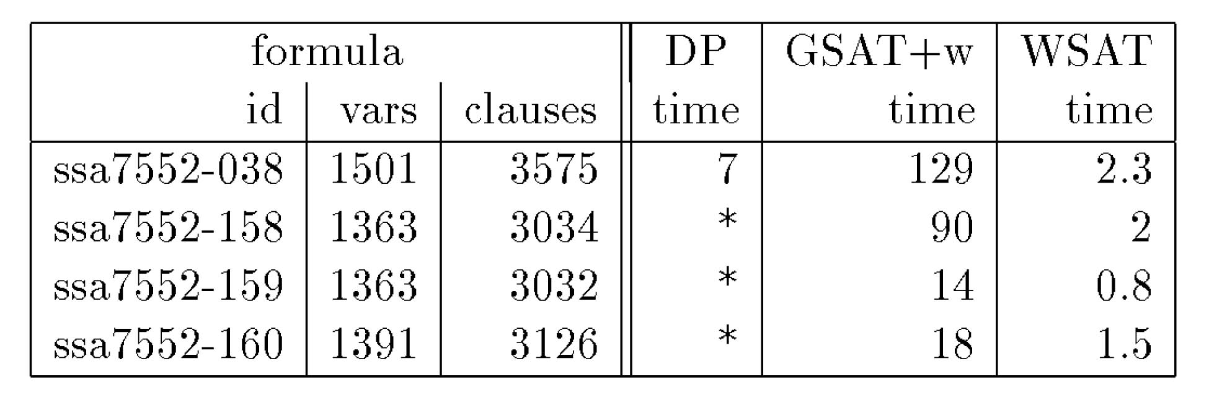
Effect of Walksat Optimizations

Slide 55
Walksat Today
Hard random 3-SAT: 100,000 vars, 10 minutes
  Walksat (or slight variations) winner every year in “random formula” track of International SAT Solver Competition
  Complete search methods (DPLL): 700 variables
“Friendly” encoded problems (graph coloring, n-queens, ...): similar order of magnitude
Inspired huge body of research linking SAT testing to statistical physics (spin glasses)

Slide 56
Implementing Walksat Efficiently
state = random truth assignment;
while ! GoalTest(state) do
  clause := random member { C | C is false in state };
  for each x in clause do compute break[x];
  if exists x with break[x]=0 then var := x;
  else
  with probability noise do
  var := random member { x | x is in clause };
  else
  var := arg_min(x) { break[x] | x is in clause };
  endif
  state[var] := 1 – state[var];
end
return state;

Slide 57
Implementing Walksat Efficiently
state = random truth assignment;
while ! GoalTest(state) do
  clause := random member { C | C is false in state };
  for each x in clause do compute break[x];
  if exists x with break[x]=0 then var := x;
  else
  with probability noise do
  var := random member { x | x is in clause };
  else
  var := arg_min(x) { break[x] | x is in clause };
  endif
  state[var] := 1 – state[var];
end
return state;

Slide 58
Picking a Random Unsatisfied Clause
Maintain a list U of (pointers to the) clauses that are currently unsatisfied. Initialize this list after the initial random truth assignment is chosen
Choose a random element from the list by choosing a random number i from the range[1 .. length of U], and then returning element U[i].
Use an array to store the list. Delete an element by swapping last element into position occupied by deleted element.

Slide 59
Computing Break Efficiently
  For each literal (positive and negative), maintain a list of (pointers to) the clauses that contain that literal, and store these lists in an array C indexed by the literal.
int Break(P) {
count = 0;
L = (S[P] > 0) ? P : -P;
for each clause c in C[L]
if L is the only true literal in c then
count ++;
return count }
  If P is flipped, then where L is the original value of P, step through the clauses in C[L] and add any that have become false to U, and step through the clauses in C[-L] and remove any that used to be false and are now true.

Slide 60
Implementing DPLL Efficiently
Key idea: avoid copying partial assignment and avoid copying formula at each decision point.
Solutions:
  Decision stack keeps track of partial assignment, backtracking = popping
  Watched literal technique makes it unnecessary to ever modify original formula!
Chaff: Engineering an Efficient SAT Solver by M. Moskewicz, C. Madigan, Y. Zhao, L. Zhang, S. Malik, 39th Design Automation Conference (DAC 2001), Las Vegas, June 2001.

Slide 61
Tuesday
SatPlan demonstrations
The secret sauce: Clause Learning
Advanced problem encodings
Limits of SatPlan

