Slide 1
Logical Foundations of Artificial Intelligence
Markov Logic II

Slide 2
Markov Logic II
Summary of last class
Applications
Weight learning
Formula learning

Slide 3
Markov Networks
Undirected graphical models
Smoking
Cancer
Asthma
Cough
Log-linear model:
Weight of Feature i
Feature i

Slide 4
Inference in Markov Networks
Goal: Compute marginals & conditionals of
Exact inference is #P-complete
Conditioning on Markov blanket of a proposition x is easy, because you only have to consider cliques (formulas) that involve x :
Gibbs sampling exploits this

Slide 5
MCMC: Gibbs Sampling
state ← random truth assignment
for i ← 1 to num-samples do
for each variable x
sample x according to P(x|neighbors(x))
state ← state with new value of x
P(F) ← fraction of states in which F is true

Slide 6
Applications
Capture the Flag
Basics
Logistic regression
Hypertext classification
Information retrieval
Entity resolution
Hidden Markov models
Information extraction
Statistical parsing
Semantic processing
Bayesian networks
Relational models
Robot mapping
Planning and MDPs
Practical tips

Slide 7
Constraints
Player location critical for recognizing events
Capture requires players to be within an arm's reach
Consumer grade GPS loggers do not appear to have required accuracy
Error: 1 – 10 meters, typically 3 meters
Relative error: no better!
Differences in individual units much larger than systematic component of GPS error

Slide 8
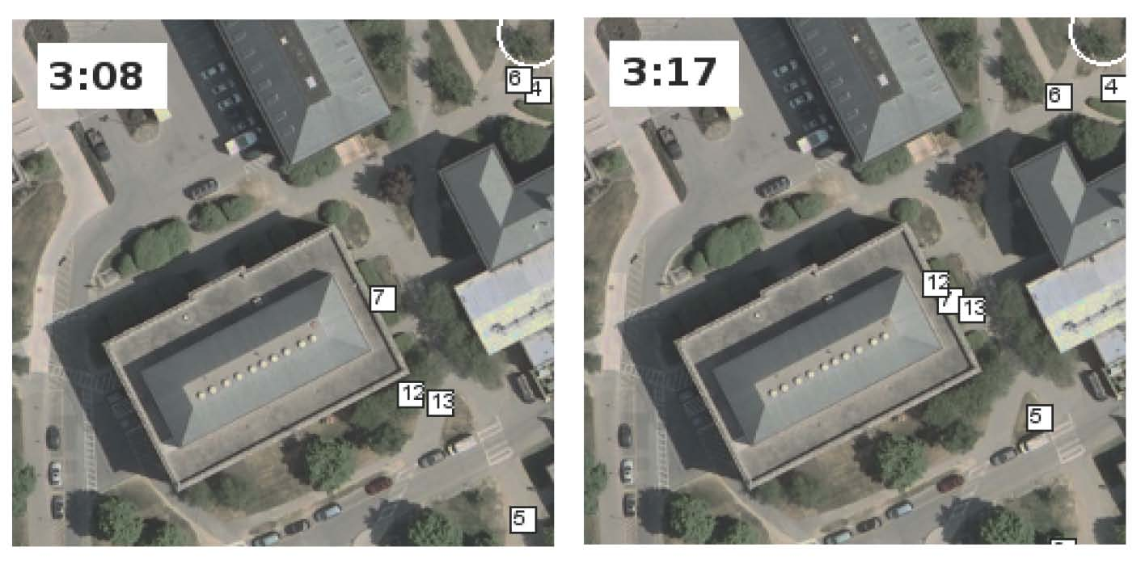
Difficult Example
Did player 7 capture player 12 or player 13?
Can we solve this problem ourselves?

Slide 9
Difficult Example
40 seconds later, we see:
13 isn't moving
Another defender, 6 isn't trying to capture 13
12 is moving
Therefore, 7 must have captured 13!

Slide 10
Approach
Solve localization and joint activity recognition simultaneously for all players
Inputs:
Raw GPS data from each player
Spatial constraints
Rules of Capture the Flag
Output:
Most likely joint trajectory of all players
Joint (and individual) activities

Slide 11
Relational Reasoning
This is a problem in relational inference
Estimate of each player's location & activities affects estimates for other players
Rules of the game are declarative and logical
A player might cheat, but the rules are the rules!
Tool: Markov Logic (Domingos 2006)
Statistical-relational KR system
Syntax: first-order logic + weights
Defines a conditional random field

Slide 12
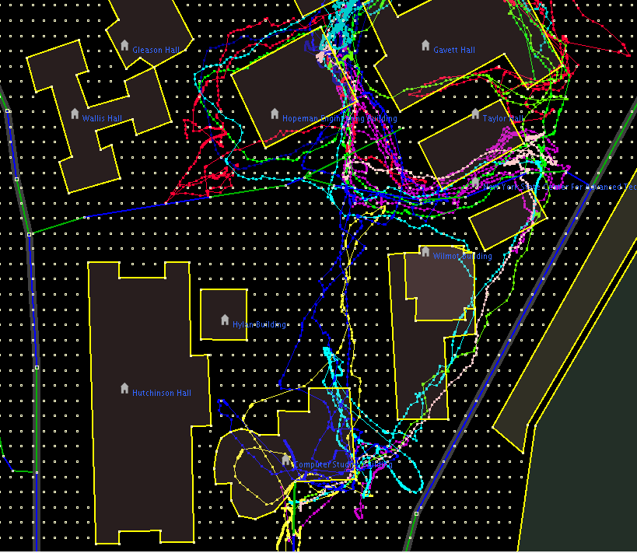
Denoising GPS Data: Snapping

Slide 13
Snapping

Slide 14
Snapping

Slide 15
Soft Rules for Snapping (Localization)

Slide 16
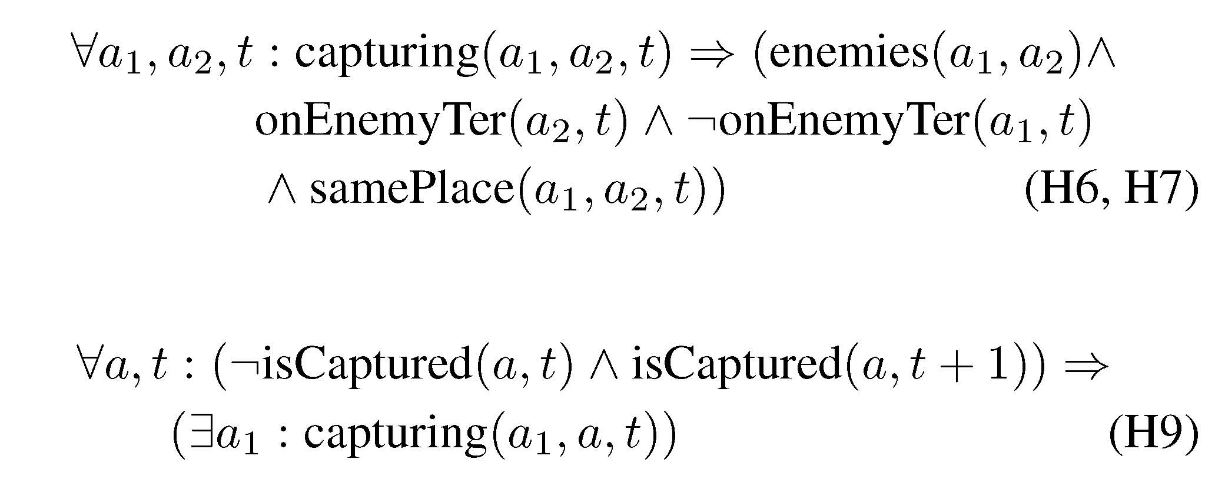
Hard Rules for Capturing

Slide 17
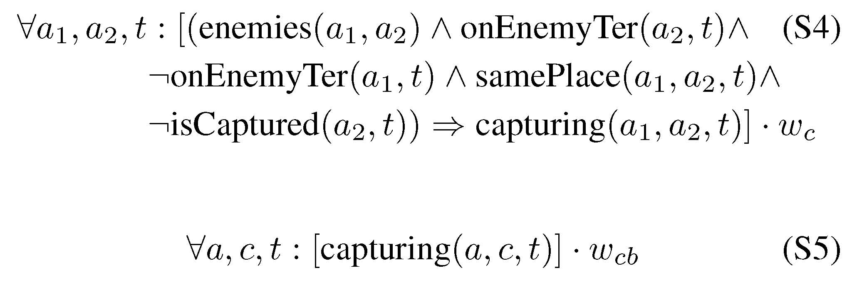
Soft Rules for Capturing

Slide 18
Comparison
Baseline
Snap to nearest 3 meter cell
If A next to B on A's territory, A captures B
Expect high recall, low precision
Baseline+States
Like baseline, but keep memory of players state {captured, not captured}
Expect better precision, possibly lower recall
2-Stage Markov Logic Model
Find most likely explanation using ML theory about location
Use as input to ML theory about capture
Unified Markov Logic Model
Find most likely explanation using entire axiom set

Slide 19
Capture The Flag Dataset
3 games
2 teams, 7 players each
GPS data logged each second
Games are 4, 14, and 17 minutes long
 | length of game (minutes) | # GPS readings | # Captures | # Frees
Game 1 | 16 | 13,412 | 2 | 2
Game 2 | 17 | 14,400 | 2 | 2
Game 3 | 4 | 3,472 | 6 | 0
Game 4 | 12 | 10,450 | 3 | 1
Total | 49 | 31,284 | 10 | 5

Slide 20
Results for Recognizing Captures
Sadilek & Kautz AAAI 2010

Slide 21
Uniform Distribn.: Empty MLN
Example: Unbiased coin flips
Type: flip = { 1, … , 20 }
Predicate: Heads(flip)

Slide 22
Binomial Distribn.: Unit Clause
Example: Biased coin flips
Type: flip = { 1, … , 20 }
Predicate: Heads(flip)
Formula: Heads(f)
Weight: Log odds of heads:
By default, MLN includes unit clauses for all predicates
(captures marginal distributions, etc.)

Slide 23
Multinomial Distribution
Example: Throwing die
Types: throw = { 1, … , 20 }
face = { 1, … , 6 }
Predicate: Outcome(throw,face)
Formulas: Outcome(t,f) ^ f != f’ => !Outcome(t,f’).
Exist f Outcome(t,f).
Too cumbersome!

Slide 24
Multinomial Distrib.: ! Notation
Example: Throwing die
Types: throw = { 1, … , 20 }
face = { 1, … , 6 }
Predicate: Outcome(throw,face!)
Formulas:
Semantics: Arguments without “!” determine arguments with “!”.
Also makes inference more efficient (triggers blocking).

Slide 25
Multinomial Distrib.: + Notation
Example: Throwing biased die
Types: throw = { 1, … , 20 }
face = { 1, … , 6 }
Predicate: Outcome(throw,face!)
Formulas: Outcome(t,+f)
Semantics: Learn weight for each grounding of args with “+”.

Slide 26
Logistic Regression
Logistic regression:
Type: obj = { 1, ... , n }
Query predicate: C(obj)
Evidence predicates: F_{i}(obj)
Formulas: a C(x)
b_{i} F_{i}(x) ^ C(x)
Resulting distribution:
Therefore:
Alternative form: F_{i}(x) => C(x)

Slide 27
Text Classification
page = { 1, … , n }
word = { … }
topic = { … }
Topic(page,topic!)
HasWord(page,word)
!Topic(p,t)
HasWord(p,+w) => Topic(p,+t)

Slide 28
Text Classification
Topic(page,topic!)
HasWord(page,word)
HasWord(p,+w) => Topic(p,+t)

Slide 29
Hypertext Classification
Topic(page,topic!)
HasWord(page,word)
Links(page,page)
HasWord(p,+w) => Topic(p,+t)
Topic(p,t) ^ Links(p,p') => Topic(p',t)
Cf. S. Chakrabarti, B. Dom & P. Indyk, “Hypertext Classification
Using Hyperlinks,” in Proc. SIGMOD-1998.

Slide 30
Information Retrieval
InQuery(word)
HasWord(page,word)
Relevant(page)
InQuery(w+) ^ HasWord(p,+w) => Relevant(p)
Relevant(p) ^ Links(p,p’) => Relevant(p’)
Cf. L. Page, S. Brin, R. Motwani & T. Winograd, “The PageRank Citation
Ranking: Bringing Order to the Web,” Tech. Rept., Stanford University, 1998.

Slide 31
Entity Resolution
Problem: Given database, find duplicate records
HasToken(token,field,record)
SameField(field,record,record)
SameRecord(record,record)
HasToken(+t,+f,r) ^ HasToken(+t,+f,r’)
=> SameField(f,r,r’)
SameField(f,r,r’) => SameRecord(r,r’)
SameRecord(r,r’) ^ SameRecord(r’,r”)
=> SameRecord(r,r”)
Cf. A. McCallum & B. Wellner, “Conditional Models of Identity Uncertainty
with Application to Noun Coreference,” in Adv. NIPS 17, 2005.

Slide 32
Entity Resolution
Can also resolve fields:
HasToken(token,field,record)
SameField(field,record,record)
SameRecord(record,record)
HasToken(+t,+f,r) ^ HasToken(+t,+f,r’)
=> SameField(f,r,r’)
SameField(f,r,r’) <=> SameRecord(r,r’)
SameRecord(r,r’) ^ SameRecord(r’,r”)
=> SameRecord(r,r”)
SameField(f,r,r’) ^ SameField(f,r’,r”)
=> SameField(f,r,r”)
More: P. Singla & P. Domingos, “Entity Resolution with
Markov Logic”, in Proc. ICDM-2006.

Slide 33
Hidden Markov Models
obs = { Obs1, … , ObsN }
state = { St1, … , StM }
time = { 0, … , T }
State(state!,time)
Obs(obs!,time)
State(+s,0)
State(+s,t) => State(+s',t+1)
Obs(+o,t) => State(+s,t)

Slide 34
Information Extraction
Problem: Extract database from text or semi-structured sources
Example: Extract database of publications from citation list(s) (the “CiteSeer problem”)
Two steps:
Segmentation: Use HMM to assign tokens to fields
Entity resolution: Use logistic regression and transitivity

Slide 35
Information Extraction
Token(token, position, citation)
InField(position, field, citation)
SameField(field, citation, citation)
SameCit(citation, citation)
Token(+t,i,c) => InField(i,+f,c)
InField(i,+f,c) <=> InField(i+1,+f,c)
f != f’ => (!InField(i,+f,c) v !InField(i,+f’,c))
Token(+t,i,c) ^ InField(i,+f,c) ^ Token(+t,i’,c’)
^ InField(i’,+f,c’) => SameField(+f,c,c’)
SameField(+f,c,c’) <=> SameCit(c,c’)
SameField(f,c,c’) ^ SameField(f,c’,c”) => SameField(f,c,c”)
SameCit(c,c’) ^ SameCit(c’,c”) => SameCit(c,c”)

Slide 36
Information Extraction
Token(token, position, citation)
InField(position, field, citation)
SameField(field, citation, citation)
SameCit(citation, citation)
Token(+t,i,c) => InField(i,+f,c)
InField(i,+f,c) ^ !Token(“.”,i,c) <=> InField(i+1,+f,c)
f != f’ => (!InField(i,+f,c) v !InField(i,+f’,c))
Token(+t,i,c) ^ InField(i,+f,c) ^ Token(+t,i’,c’)
^ InField(i’,+f,c’) => SameField(+f,c,c’)
SameField(+f,c,c’) <=> SameCit(c,c’)
SameField(f,c,c’) ^ SameField(f,c’,c”) => SameField(f,c,c”)
SameCit(c,c’) ^ SameCit(c’,c”) => SameCit(c,c”)
More: H. Poon & P. Domingos, “Joint Inference in Information
Extraction”, in Proc. AAAI-2007. (Tomorrow at 4:20.)

Slide 37
Statistical Parsing
Input: Sentence
Output: Most probable parse
PCFG: Production rules with probabilities
E.g.: 0.7 NP → N
0.3 NP → Det N
WCFG: Production rules with weights (equivalent)
Chomsky normal form:
A → B C or A → a
S
VP
NP
NP
V
N
Det
N
John ate the pizza

Slide 38
Statistical Parsing
Evidence predicate: Token(token,position)
E.g.: Token(“pizza”, 3)
Query predicates: Constituent(position,position)
E.g.: NP(2,4)
For each rule of the form A → B C: Clause of the form B(i,j) ^ C(j,k) => A(i,k)
E.g.: NP(i,j) ^ VP(j,k) => S(i,k)
For each rule of the form A → a: Clause of the form Token(a,i) => A(i,i+1)
E.g.: Token(“pizza”, i) => N(i,i+1)
For each nonterminal: Hard formula stating that exactly one production holds
MAP inference yields most probable parse

Slide 39
Semantic Processing
Weighted definite clause grammars: Straightforward extension
Combine with entity resolution: NP(i,j) => Entity(+e,i,j)
Word sense disambiguation: Use logistic regression
Semantic role labeling: Use rules involving phrase predicates
Building meaning representation: Via weighted DCG with lambda calculus (cf. Zettlemoyer & Collins, UAI-2005)
Another option: Rules of the form Token(a,i) => Meaning and MeaningB ^ MeaningC ^ … => MeaningA
Facilitates injecting world knowledge into parsing

Slide 40
Semantic Processing
Example: John ate pizza.
Grammar: S → NP VP VP → V NP V → ate
NP → John NP → pizza
Token(“John”,0) => Participant(John,E,0,1)
Token(“ate”,1) => Event(Eating,E,1,2)
Token(“pizza”,2) => Participant(pizza,E,2,3)
Event(Eating,e,i,j) ^ Participant(p,e,j,k)
^ VP(i,k) ^ V(i,j) ^ NP(j,k) => Eaten(p,e)
Event(Eating,e,j,k) ^ Participant(p,e,i,j)
^ S(i,k) ^ NP(i,j) ^ VP(j,k) => Eater(p,e)
Event(t,e,i,k) => Isa(e,t)
Result: Isa(E,Eating), Eater(John,E), Eaten(pizza,E)

Slide 41
Bayesian Networks
Use all binary predicates with same first argument (the object x).
One predicate for each variable A: A(x,v!)
One clause for each line in the CPT and value of the variable
Context-specific independence: One Horn clause for each path in the decision tree
Logistic regression: As before
Noisy OR: Deterministic OR + Pairwise clauses

Slide 42
Robot Mapping
Input: Laser range finder segments (x_{i}, y_{i}, x_{f}, y_{f})
Outputs:
Segment labels (Wall, Door, Other)
Assignment of wall segments to walls
Position of walls (x_{i}, y_{i}, x_{f}, y_{f})

Slide 43
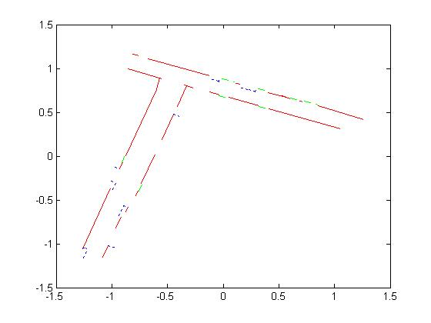
Robot Mapping

Slide 44
MLNs for Hybrid Domains
Allow numeric properties of objects as nodes
E.g.: Length(x), Distance(x,y)
Allow numeric terms as features
E.g.: –(Length(x) – 5.0)²
(Gaussian distr. w/ mean = 5.0 and variance = 1/(2w))
Allow α = β as shorthand for –(α – β)²
E.g.: Length(x) = 5.0
Etc.

Slide 45
Robot Mapping
SegmentType(s,+t) => Length(s) = Length(+t)
SegmentType(s,+t) => Depth(s) = Depth(+t)
Neighbors(s,s’) ^ Aligned(s,s’) =>
(SegType(s,+t) <=> SegType(s’,+t))
!PreviousAligned(s) ^ PartOf(s,l) => StartLine(s,l)
StartLine(s,l) => Xi(s) = Xi(l) ^ Yi(s) = Yi(l)
PartOf(s,l) => =
Etc.
Cf. B. Limketkai, L. Liao & D. Fox, “Relational Object Maps for
Mobile Robots”, in Proc. IJCAI-2005.
Yf(s)-Yi(s) Yi(s)-Yi(l)
Xf(s)-Xi(s) Xi(s)-Xi(l)

Slide 46
Practical Tips
Add all unit clauses (the default)
Implications vs. conjunctions
Open/closed world assumptions
How to handle uncertain data: R(x,y) => R’(x,y) (the “HMM trick”)
Controlling complexity
Low clause arities
Low numbers of constants
Short inference chains
Use the simplest MLN that works
Cycle: Add/delete formulas, learn and test

Slide 47
Learning Markov Networks
Learning parameters (weights)
Generatively
Discriminatively
Learning structure (features)
In this tutorial: Assume complete data (If not: EM versions of algorithms)

Slide 48
Generative Weight Learning
Maximize likelihood or posterior probability
Numerical optimization (gradient or 2nd order)
No local maxima
Requires inference at each step (slow!)
No. of times feature i is true in data
Expected no. times feature i is true according to model

Slide 49
Pseudo-Likelihood
Likelihood of each variable given its neighbors in the data
Does not require inference at each step
Consistent estimator
Widely used in vision, spatial statistics, etc.
But PL parameters may not work well for long inference chains

Slide 50
Discriminative Weight Learning
Maximize conditional likelihood of query (y) given evidence (x)
Approximate expected counts by counts in MAP state of y given x
No. of true groundings of clause i in data
Expected no. true groundings according to model

Slide 51
Rule Induction
Given: Set of positive and negative examples of some concept
Example: (x₁, x₂, … , x_{n}, y)
y: concept (Boolean)
x₁, x₂, … , x_{n}: attributes (assume Boolean)
Goal: Induce a set of rules that cover all positive examples and no negative ones
Rule: x_{a} ^ x_{b} ^ … -> y (x_{a}: Literal, i.e., x_{i} or its negation)
Same as Horn clause: Body ⇒ Head
Rule r covers example x iff x satisfies body of r
Eval(r): Accuracy, info. gain, coverage, support, etc.

Slide 52
Learning a Single Rule
head ← y
body ← Ø
repeat
for each literal x
r_{x} ← r with x added to body
Eval(r_{x})
body ← body ^ best x
until no x improves Eval(r)
return r

Slide 53
Learning a Set of Rules
R ← Ø
S ← examples
repeat
learn a single rule r
R ← R U { r }
S ← S − positive examples covered by r
until S contains no positive examples
return R

Slide 54
First-Order Rule Induction
y and x_{i} are now predicates with arguments E.g.: y is Ancestor(x,y), x_{i} is Parent(x,y)
Literals to add are predicates or their negations
Literal to add must include at least one variable already appearing in rule
Adding a literal changes # groundings of rule E.g.: Ancestor(x,z) ^ Parent(z,y) -> Ancestor(x,y)
Eval(r) must take this into account E.g.: Multiply by # positive groundings of rule still covered after adding literal

Slide 55
Thursday
Summary of everything since the midterm
Gödels completeness and incompleteness theorems

